Slide 1
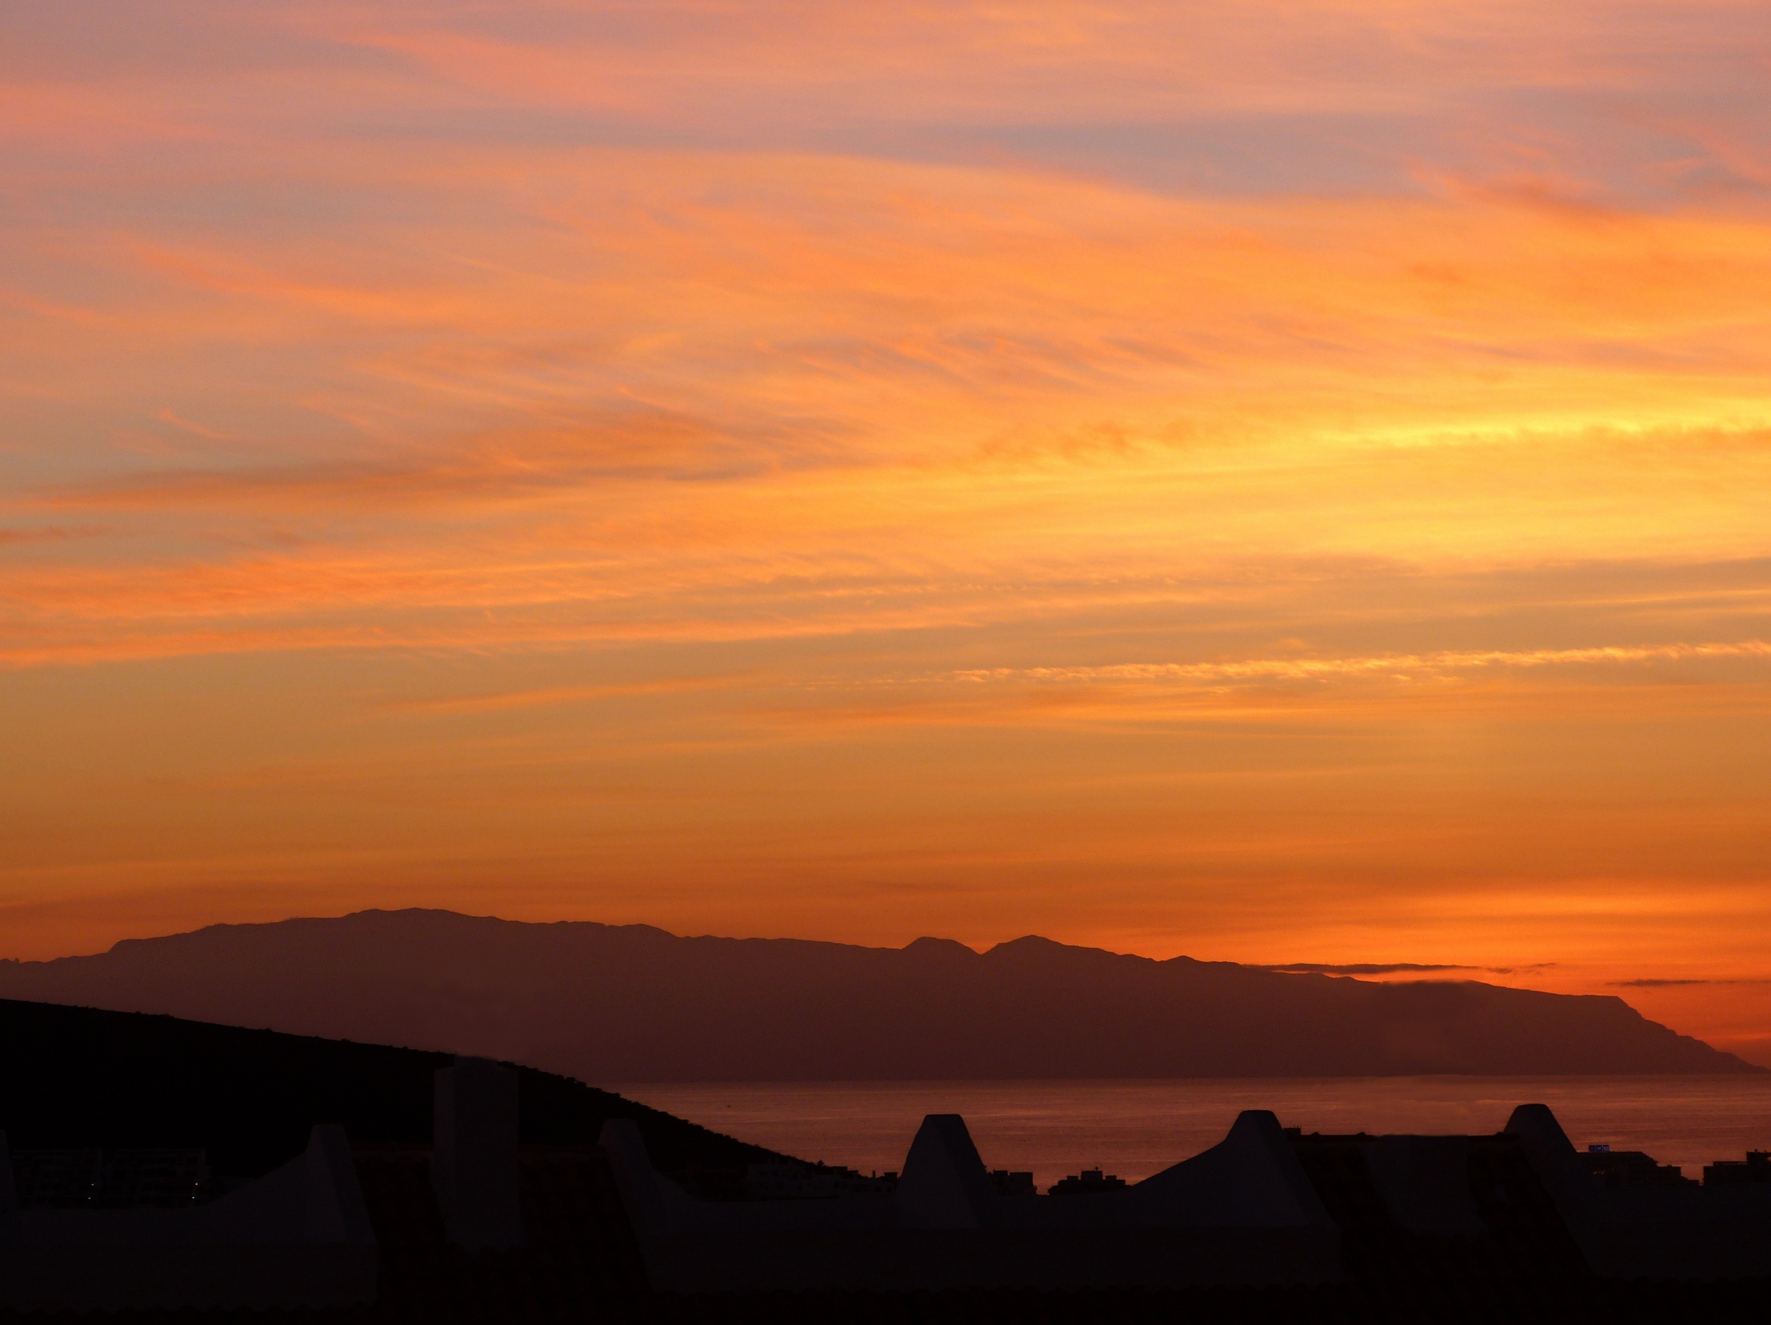
The heart of the gospel
John 12:20-50

Slide 2
The heart of the gospel
John 12:20-50
Tragedy/blessing

Slide 3
The heart of the gospel
John 12:20-50
Tragedy/blessing
Greek “God-fearers”

Slide 4
The heart of the gospel
John 12:20-50
1. The Greek’s request (vv.20-22)

Slide 5
The heart of the gospel
John 12:20-50
1. The Greek’s request (vv.20-22)
Why Philip & Andrew?

Slide 6
The heart of the gospel
John 12:20-50
The Greek’s request (vv.20-22)
Jesus’ response (vv.23-26)

Slide 7
The heart of the gospel
John 12:20-50
The Greek’s request (vv.20-22)
Jesus’ response (vv.23-26)
His “hour” had come

Slide 8
The heart of the gospel
John 12:20-50
The Greek’s request (vv.20-22)
Jesus’ response (vv.23-26)
His “hour” had come
Jesus’ parable

Slide 9
The heart of the gospel
John 12:20-50
The Greek’s request (vv.20-22)
Jesus’ response (vv.23-26)
His “hour” had come
Jesus’ parable
The significance

Slide 10
The heart of the gospel
John 12:20-50
The Greek’s request (vv.20-22)
Jesus’ response (vv.23-26)
Jesus’ anguish (vv.27-28)

Slide 11
The heart of the gospel
John 12:20-50
The Greek’s request (vv.20-22)
Jesus’ response (vv.23-26)
Jesus’ anguish (vv.27-28)
A rhetorical question v.27

Slide 12
The heart of the gospel
John 12:20-50
The Greek’s request (vv.20-22)
Jesus’ response (vv.23-26)
Jesus’ anguish (vv.27-28)
A rhetorical question v.27
The divine response v.28

Slide 13
The heart of the gospel
John 12:20-50
The Greek’s request (vv.20-22)
Jesus’ response (vv.23-26)
Jesus’ anguish (vv.27-28)
A rhetorical question v.27
The divine response v.28
Mixed interpretations v.29

Slide 14
The heart of the gospel
John 12:20-50
The Greek’s request (vv.20-22)
Jesus’ response (vv.23-26)
Jesus’ anguish (vv.27-28)
Jesus’ declaration (vv.30-33)

Slide 15
The heart of the gospel
John 12:20-50
The Greek’s request (vv.20-22)
Jesus’ response (vv.23-26)
Jesus’ anguish (vv.27-28)
Jesus’ declaration (vv.30-33)
The crowd’s confusion (v.34)

Slide 16
The heart of the gospel
John 12:20-50
The Greek’s request (vv.20-22)
Jesus’ response (vv.23-26)
Jesus’ anguish (vv.27-28)
Jesus’ declaration (vv.30-33)
The crowd’s confusion (v.34)
Truth and hearsay

Slide 17
The heart of the gospel
John 12:20-50
The Greek’s request (vv.20-22)
Jesus’ response (vv.23-26)
Jesus’ anguish (vv.27-28)
Jesus’ declaration (vv.30-33)
The crowd’s confusion (v.34)
Truth and hearsay
Limited possibilities

Slide 18
The heart of the gospel
John 12:20-50
The Greek’s request (vv.20-22)
Jesus’ response (vv.23-26)
Jesus’ anguish (vv.27-28)
Jesus’ declaration (vv.30-33)
The crowd’s confusion (v.34)
Jesus’ final words (vv.35-36)

Slide 19
The heart of the gospel
John 12:20-50
The Greek’s request (vv.20-22)
Jesus’ response (vv.23-26)
Jesus’ anguish (vv.27-28)
Jesus’ declaration (vv.30-33)
The crowd’s confusion (v.34)
Jesus’ final words (vv.35-36)
The dilemma of unbelief (vv.38-41)

Slide 20
The heart of the gospel
John 12:20-50
The Greek’s request (vv.20-22)
Jesus’ response (vv.23-26)
Jesus’ anguish (vv.27-28)
Jesus’ declaration (vv.30-33)
The crowd’s confusion (v.34)
Jesus’ final words (vv.35-36)
The dilemma of unbelief (vv.38-41)
Failed ministry?

Slide 21
The heart of the gospel
John 12:20-50
The Greek’s request (vv.20-22)
Jesus’ response (vv.23-26)
Jesus’ anguish (vv.27-28)
Jesus’ declaration (vv.30-33)
The crowd’s confusion (v.34)
Jesus’ final words (vv.35-36)
The dilemma of unbelief (vv.38-41)
Failed ministry?
Fulfilment of prophecy – see Luke 24:25-26

Slide 22
The heart of the gospel
John 12:20-50
The Greek’s request (vv.20-22)
Jesus’ response (vv.23-26)
Jesus’ anguish (vv.27-28)
Jesus’ declaration (vv.30-33)
The crowd’s confusion (v.34)
Jesus’ final words (vv.35-36)
The dilemma of unbelief (vv.38-41)
Camouflaged believers (vv.42-43)

Slide 23
The heart of the gospel
John 12:20-50
The Greek’s request (vv.20-22)
Jesus’ response (vv.23-26)
Jesus’ anguish (vv.27-28)
Jesus’ declaration (vv.30-33)
The crowd’s confusion (v.34)
Jesus’ final words (vv.35-36)
The dilemma of unbelief (vv.38-41)
Camouflaged believers (vv.42-43)
Couldn’t thwart God’s plan

Slide 24
The heart of the gospel
John 12:20-50
The Greek’s request (vv.20-22)
Jesus’ response (vv.23-26)
Jesus’ anguish (vv.27-28)
Jesus’ declaration (vv.30-33)
The crowd’s confusion (v.34)
Jesus’ final words (vv.35-36)
The dilemma of unbelief (vv.38-41)
Camouflaged believers (vv.42-43)
Couldn’t thwart God’s plan
Loved human praise

Slide 25
The heart of the gospel
John 12:20-50
The Greek’s request (vv.20-22)
Jesus’ response (vv.23-26)
Jesus’ anguish (vv.27-28)
Jesus’ declaration (vv.30-33)
The crowd’s confusion (v.34)
Jesus’ final words (vv.35-36)
The dilemma of unbelief (vv.38-41)
Camouflaged believers (vv.42-43)
Couldn’t thwart God’s plan
Loved human praise
Our position?

Slide 26
The heart of the gospel
John 12:20-50
The Greek’s request (vv.20-22)
Jesus’ response (vv.23-26)
Jesus’ anguish (vv.27-28)
Jesus’ declaration (vv.30-33)
The crowd’s confusion (v.34)
Jesus’ final words (vv.35-36)
The dilemma of unbelief (vv.38-41)
Camouflaged believers (vv.42-43)
Jesus’ final appeal (vv.44-50)

Slide 27
The heart of the gospel
John 12:20-50
The Greek’s request (vv.20-22)
Jesus’ response (vv.23-26)
Jesus’ anguish (vv.27-28)
Jesus’ declaration (vv.30-33)
The crowd’s confusion (v.34)
Jesus’ final words (vv.35-36)
The dilemma of unbelief (vv.38-41)
Camouflaged believers (vv.42-43)
Jesus’ final appeal (vv.44-50)
International scope

Slide 28
The heart of the gospel
John 12:20-50
The Greek’s request (vv.20-22)
Jesus’ response (vv.23-26)
Jesus’ anguish (vv.27-28)
Jesus’ declaration (vv.30-33)
The crowd’s confusion (v.34)
Jesus’ final words (vv.35-36)
The dilemma of unbelief (vv.38-41)
Camouflaged believers (vv.42-43)
Jesus’ final appeal (vv.44-50)
International scope
Stark choice

Slide 29
The heart of the gospel
John 12:20-50
The Greek’s request (vv.20-22)
Jesus’ response (vv.23-26)
Jesus’ anguish (vv.27-28)
Jesus’ declaration (vv.30-33)
The crowd’s confusion (v.34)
Jesus’ final words (vv.35-36)
The dilemma of unbelief (vv.38-41)
Camouflaged believers (vv.42-43)
Jesus’ final appeal (vv.44-50)
Important lessons
International scope
Stark choice

Slide 30
The heart of the gospel
John 12:20-50
The Greek’s request (vv.20-22)
Jesus’ response (vv.23-26)
Jesus’ anguish (vv.27-28)
Jesus’ declaration (vv.30-33)
The crowd’s confusion (v.34)
Jesus’ final words (vv.35-36)
The dilemma of unbelief (vv.38-41)
Camouflaged believers (vv.42-43)
Jesus’ final appeal (vv.44-50)
Important lessons
Can’t separate Jesus’ words from works
International scope
Stark choice

Slide 31
The heart of the gospel
John 12:20-50
The Greek’s request (vv.20-22)
Jesus’ response (vv.23-26)
Jesus’ anguish (vv.27-28)
Jesus’ declaration (vv.30-33)
The crowd’s confusion (v.34)
Jesus’ final words (vv.35-36)
The dilemma of unbelief (vv.38-41)
Camouflaged believers (vv.42-43)
Jesus’ final appeal (vv.44-50)
Important lessons
Can’t separate Jesus’ words from works
John 12 = turning point. Accept/reject
International scope
Stark choice

